Slide 1
Spanish 2
Clothing Descriptions
Week of 4/13
Due 4/17

Slide 2
Objetivo
Objetivo: I will use clothing nouns and adjectives in order to describe what I and others are wearing.
Topic: Clothing Descriptions

Slide 3
Los colores!
Rojo | Blanco
Azul | Negro
Amarillo | Gris
Verde | Marrón
Anaranjado | Morado
Rosado

Slide 4
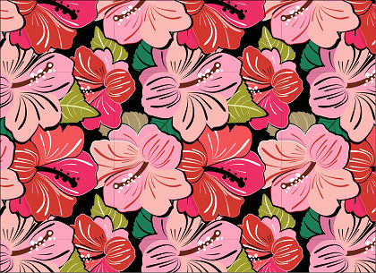
De flores - flowered

Slide 5
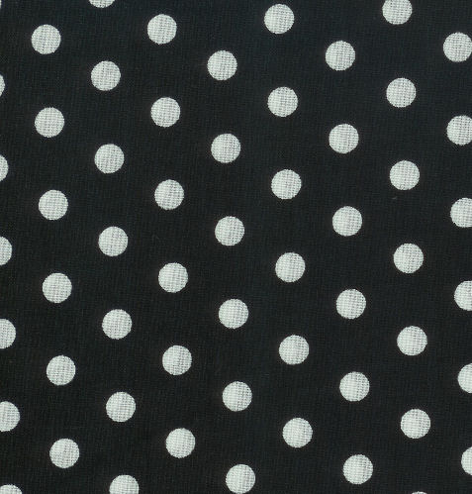
De lunares – polka dot

Slide 6
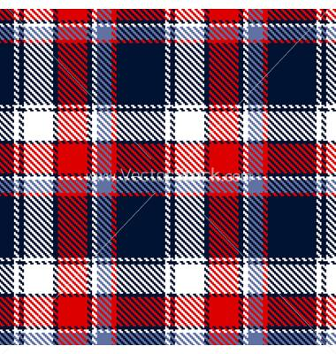
A cuadros – plaid/checkered

Slide 7
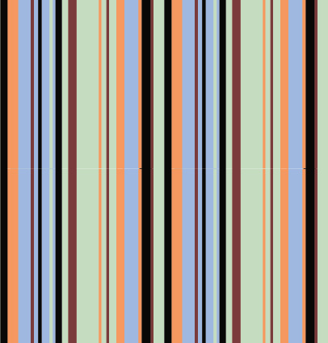
A rayas - striped

Slide 8
Claro - pale

Slide 9
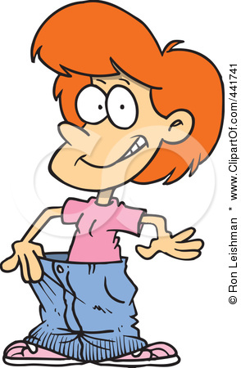
Flojo - loose

Slide 10
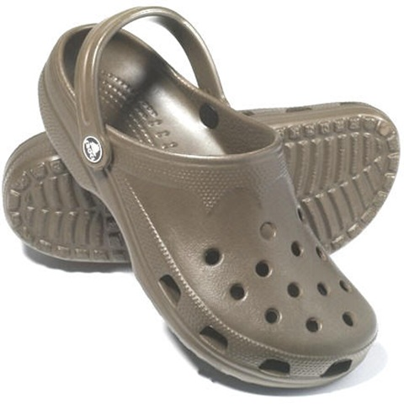
Comodo/incomodo comfortable/uncomfortable

Slide 11
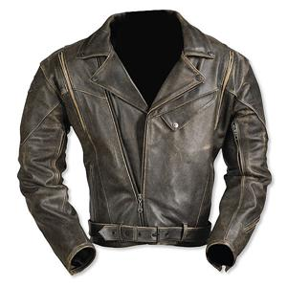
De cuero - leather

Slide 12
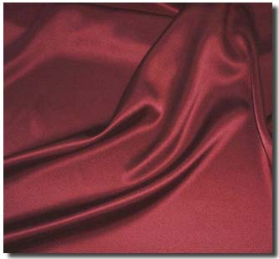
De seda - silk

Slide 13
Oscuro - dark

Slide 14
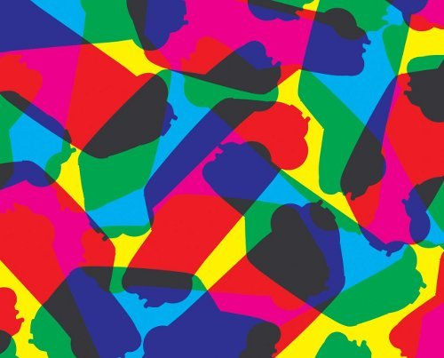
Vivo - bright

Slide 15
Pastel - pastel

Slide 16
De un solo color – solid/one color

Slide 17
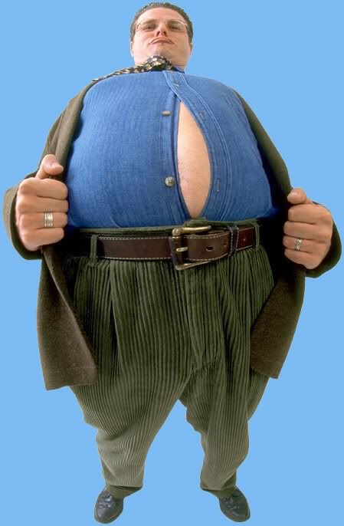
Apretado - tight

Slide 18
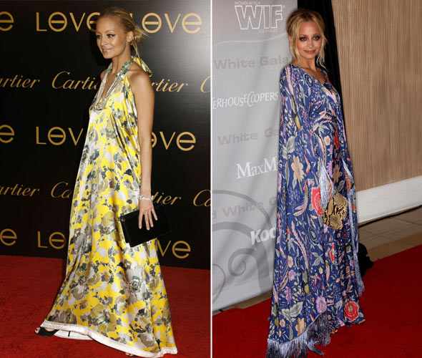
Suelto- loose

Slide 19
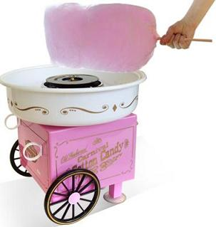
De algodón - cotton

Slide 20
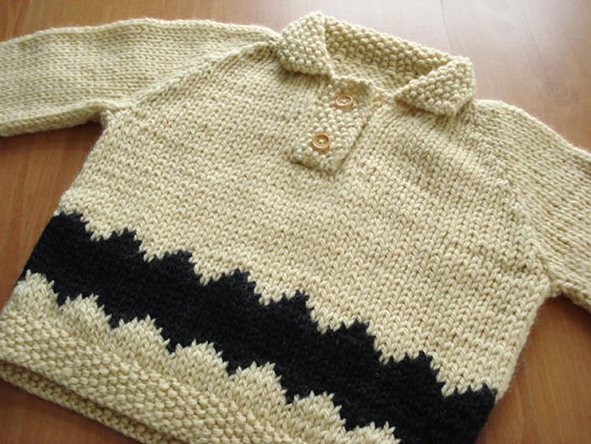
De lana - wool

Slide 21
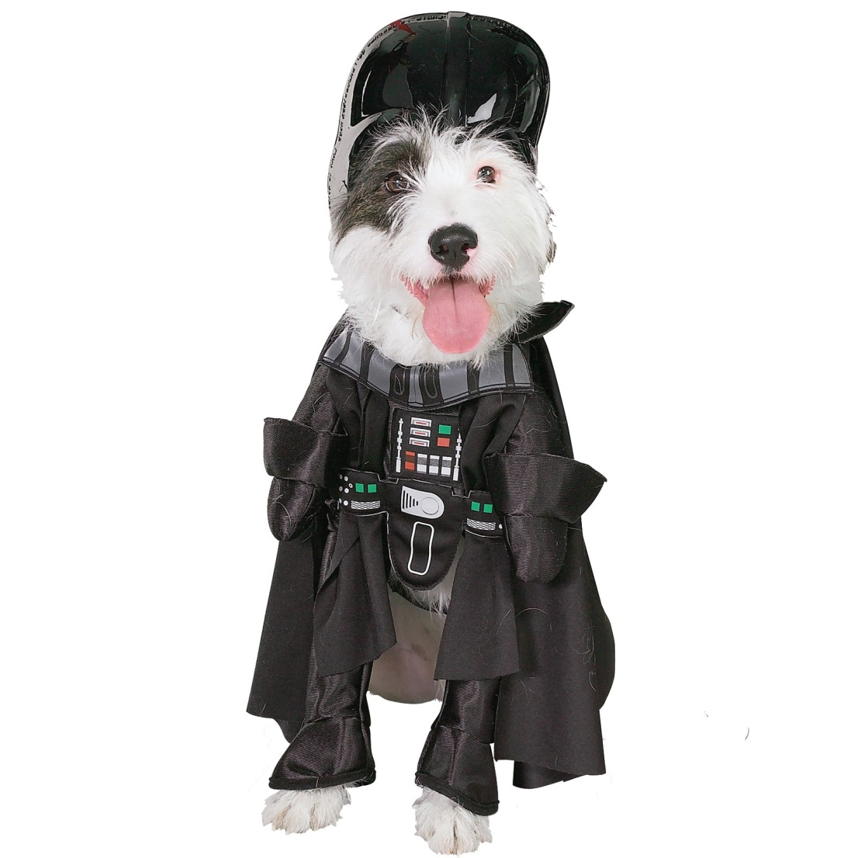
De tela sintetica – synthetic fabric

Slide 22
Remember:
AFTER
Adjectives come ______________ the noun!
Examples:
Red dress = ______________________
Cotton shirt = ____________________
Vestido rojo
Camisa de algodón

Slide 23
ALSO!!!
AGREE
Everything must always ___________!
Examples:
Yellow pants = ______________________
Comfortable t-shirt = ____________________
Pantalones amarillos
Camiseta cómoda

Slide 24
With more than one description, color comes first.

Slide 25
Write a sentence describing what the person is wearing based on what you see in the picture

Slide 30
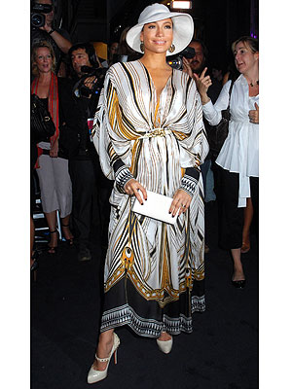

Slide 32
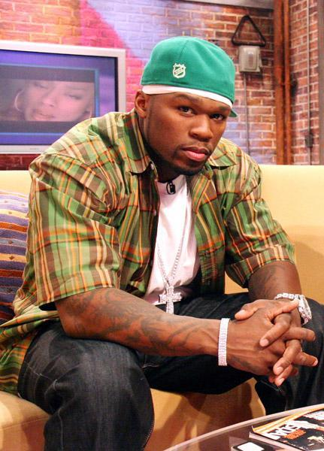

Slide 33
